Slide 1

Trusty Tails

Slide 2
Introduction
A Trusty Tails would generally refer to a centralized platform or service dedicated to enhancing the health, care, and overall well-being of pets. Such a hub might encompass various features and services aimed at supporting pet owners in managing their pets' health, buying snd selling the pets, connecting with veterinary services, accessing trainers, grooming products and more.

Slide 3
Technology Used
We used Java Spring-Boot as backend and React JS as Frontend in our Project.
Spring-Boot :–
The main goal of the Spring Boot framework is to reduce overall development time and increase efficiency. React has become the first choice for frontend because it gives developers the ability to work with a virtual browser (more friendly than the real browser). Also, a JavaScript developer can become a productive developer in a few hours because there is a small API to learn, a few functions, and how to use them…
React :–
React allows developers to create large web applications that can change data, without reloading the page. The main purpose of React is to be fast, scalable, and simple. Spring

Slide 4



User Classes
Customer
In this module a customer will register, update details or search from various categories available.
Admin
In this module Admin can manage Customers , Sellers and Products. Will maintain one to one relation.
Provider
In this module Provider can register , login and can upload their product details.

Slide 5
Objective
The Trusty Tails project aims to create a comprehensive platform that provides a centralized and user-friendly space for accessing essential pet-related services, information, and community support.
It supports pet owners in managing the health, well-being, and overall care of their pets.

Slide 6
Customer Module
After successful registration, the Customer can
Search for the pets or pet products
can edit his/her profile
Delete account
can maintain cart for reference

Slide 7
Provider Module
After successful registration and authentication from Admin, the provider can
Upload new products. Apart from this,
provider can edit his/her profile,
Can Delete their account
can change price of products

Slide 8
Admin Module
Admin can
Approve or disapprove the Provider.
He /she can see User details
Manage account and delete Provider account.
Also manages products

Slide 9
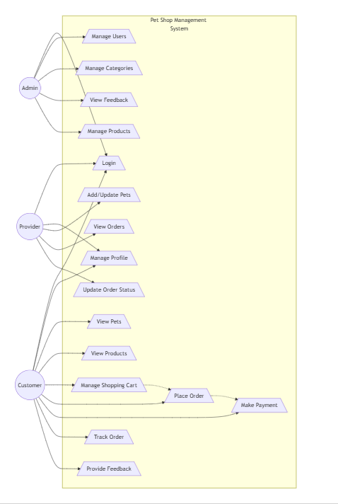
Use Case Diagram

Slide 10
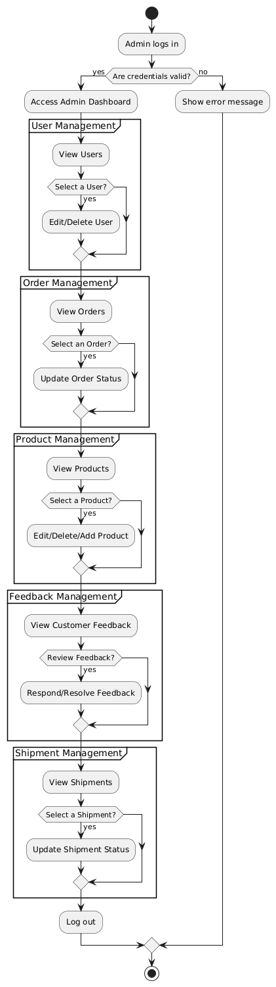
Admin Activity Diagram

Slide 11
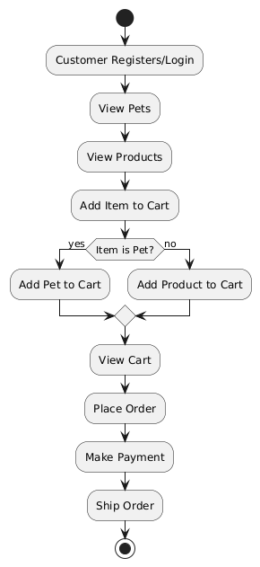
Customer Activity Diagram

Slide 12
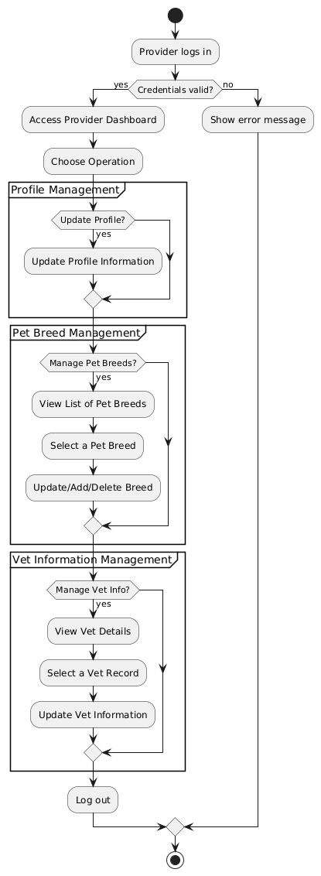
Provider Activity Diagram

Slide 13
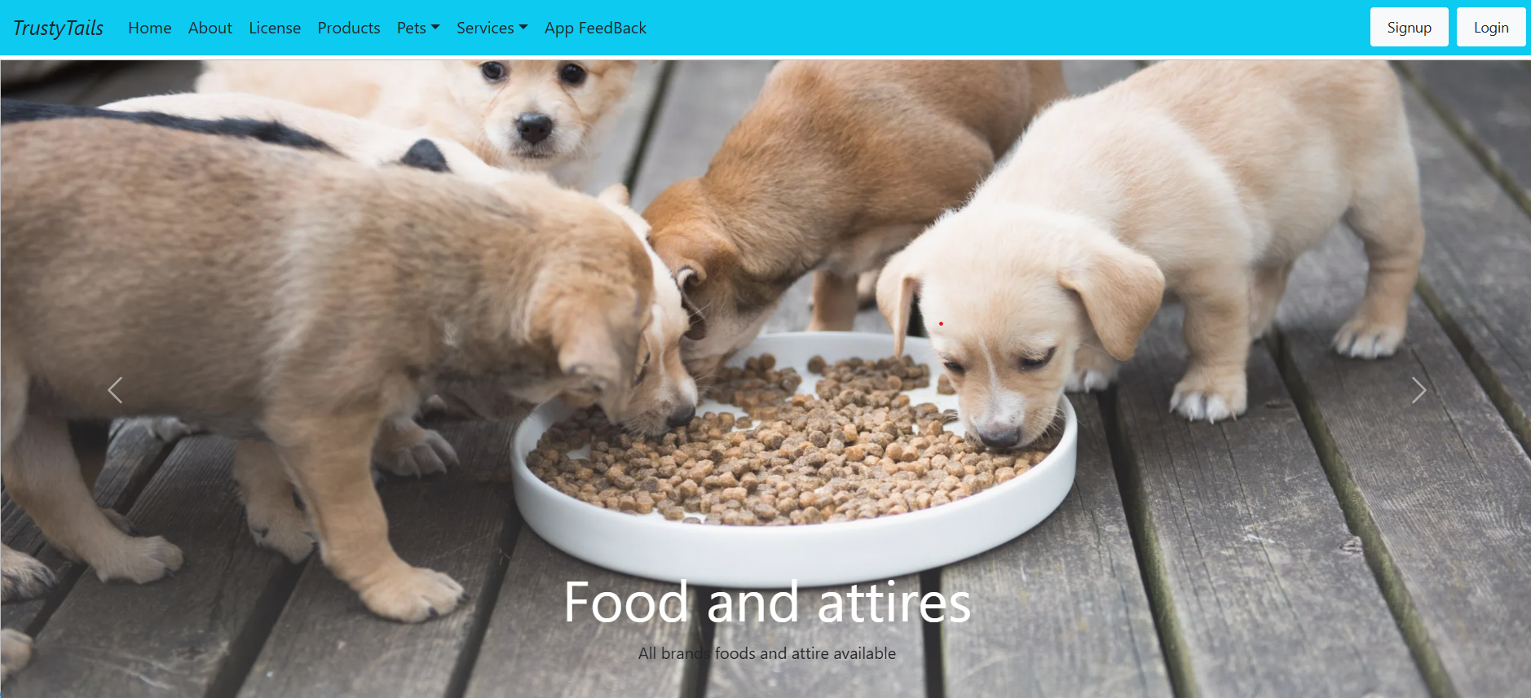

Slide 14
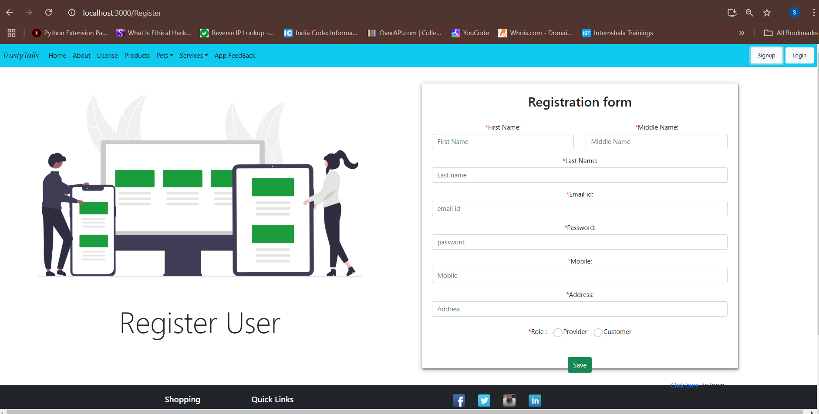

Slide 15
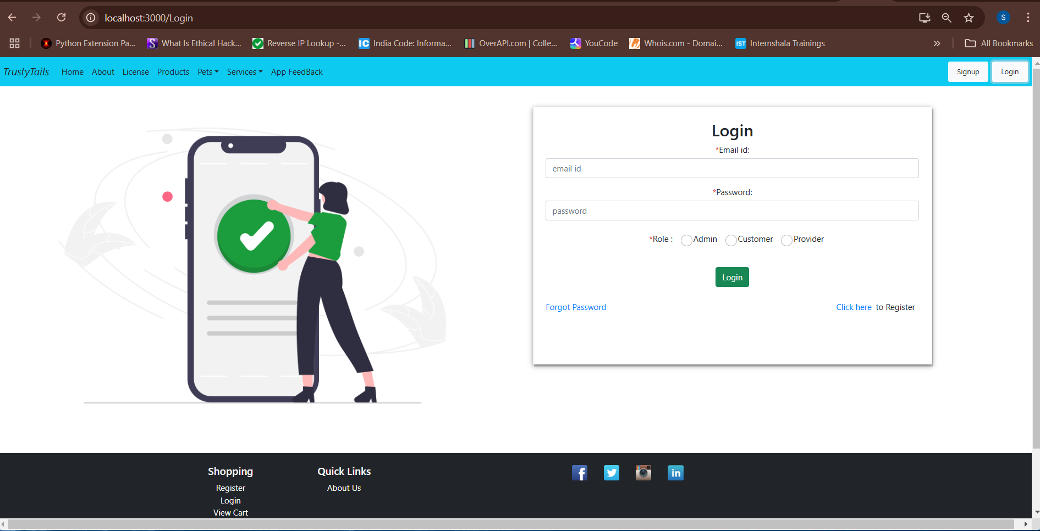

Slide 16
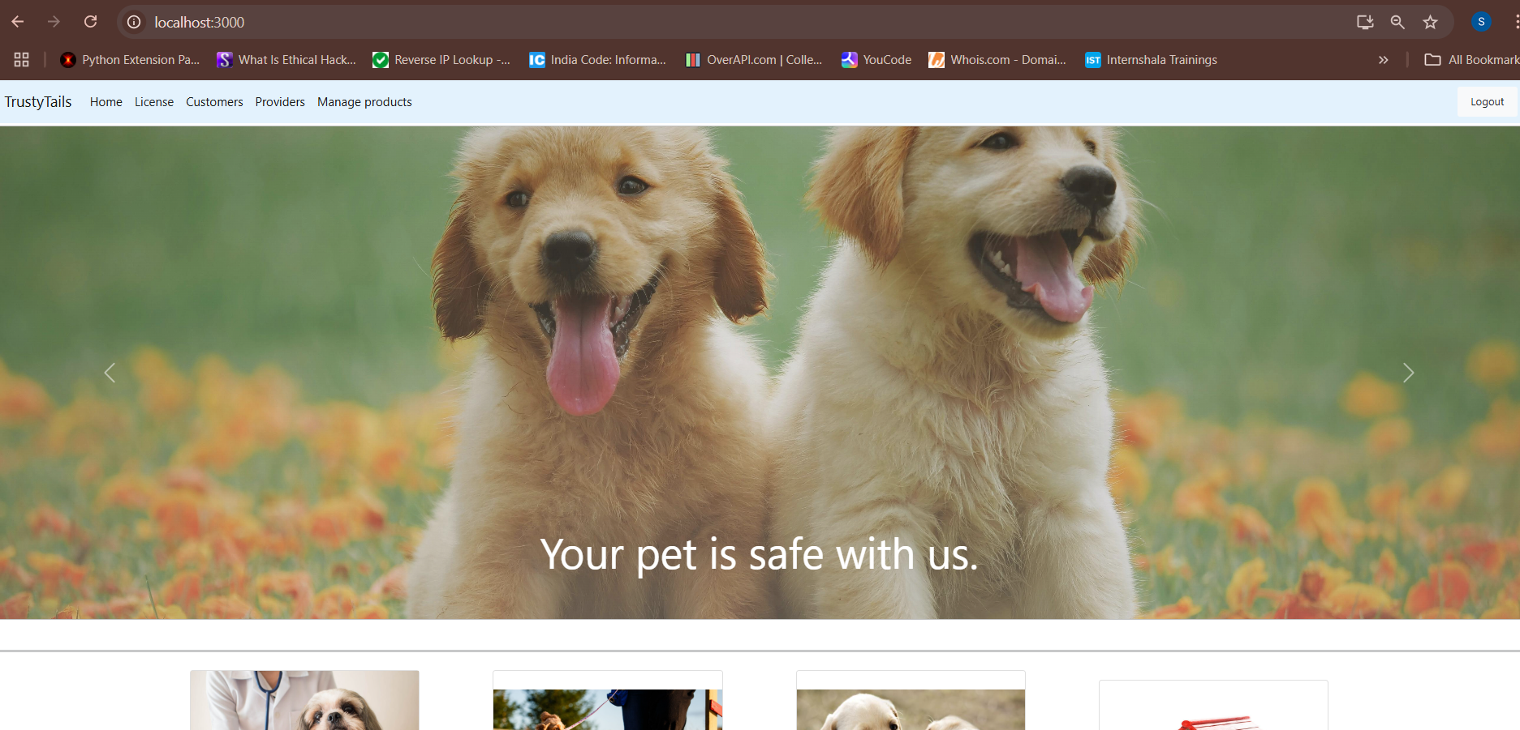

Slide 17
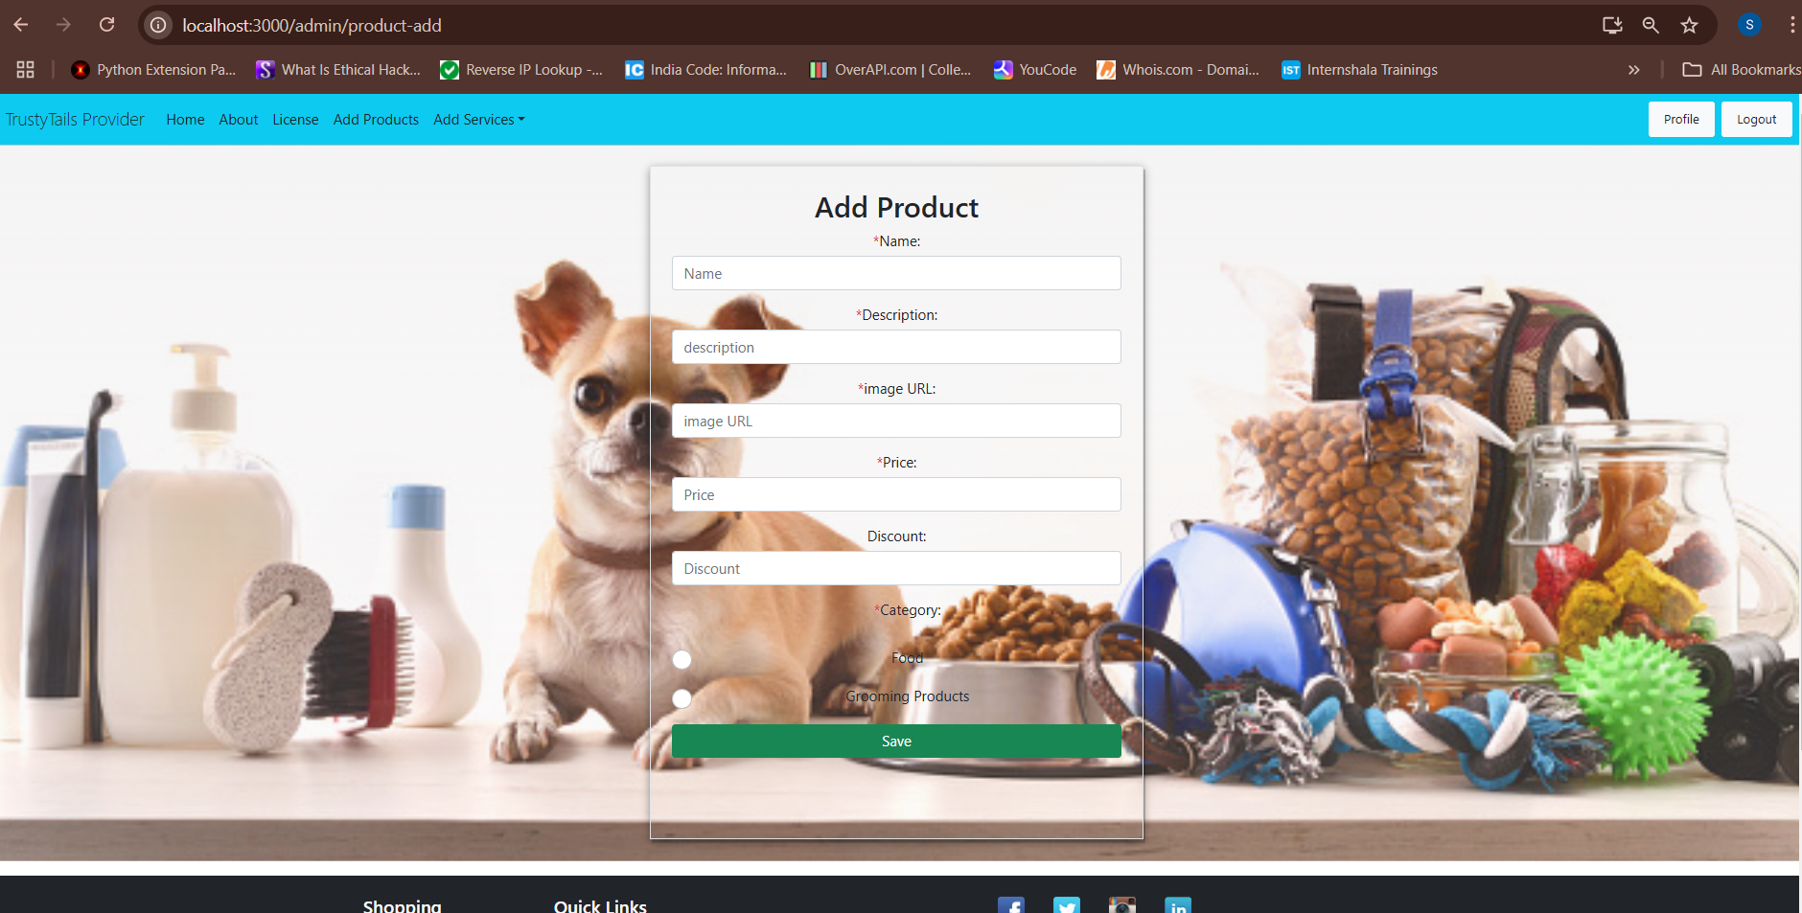

Slide 18
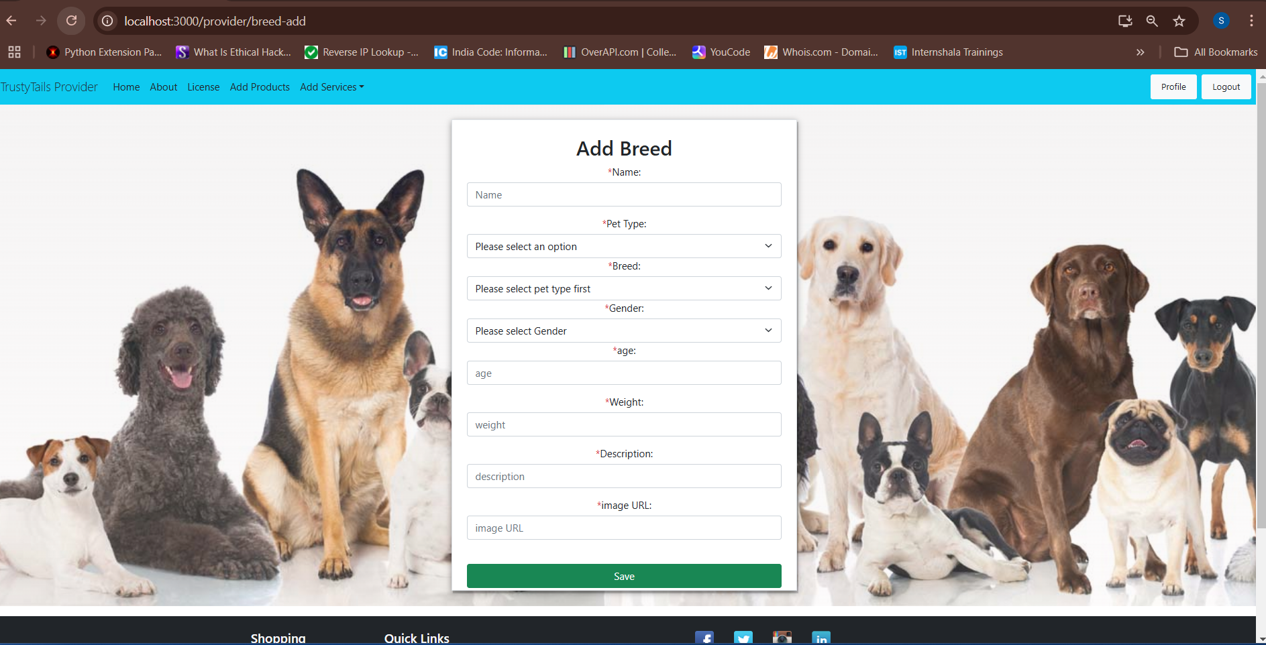

Slide 19
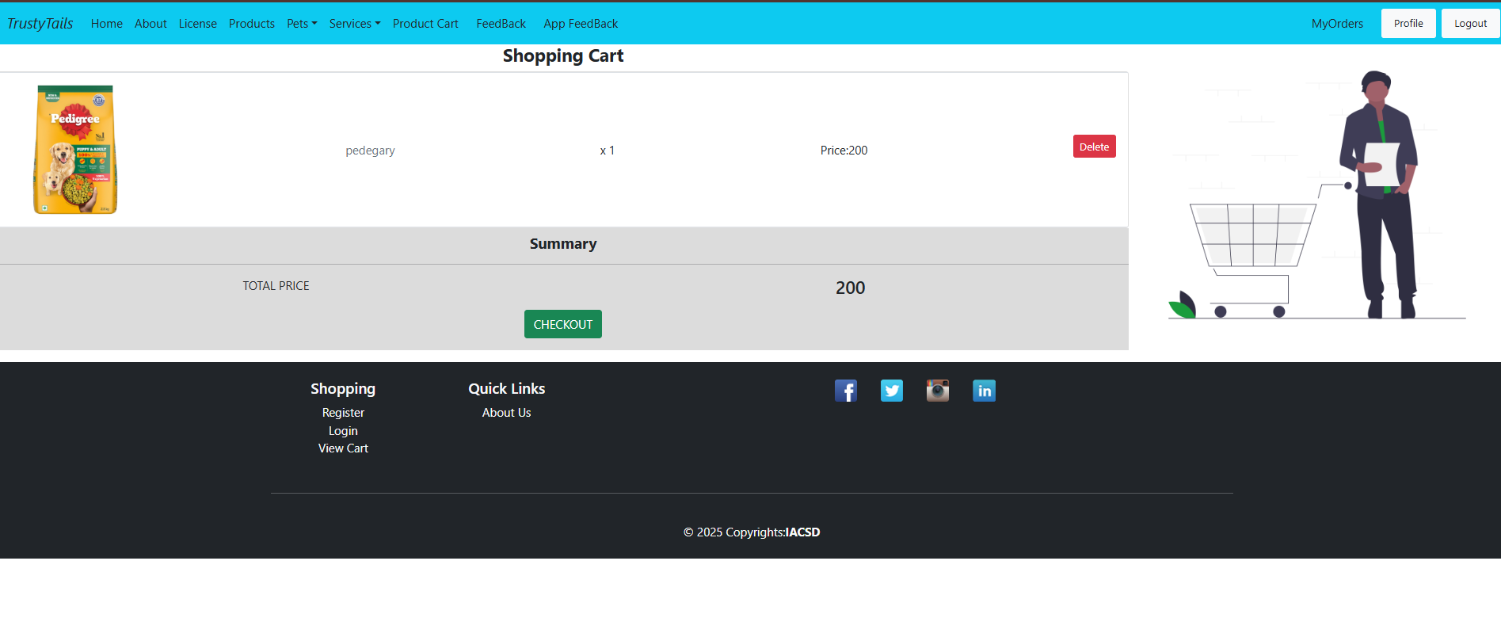

Slide 20
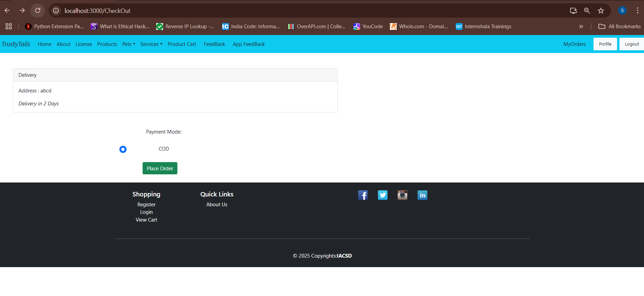

Slide 21
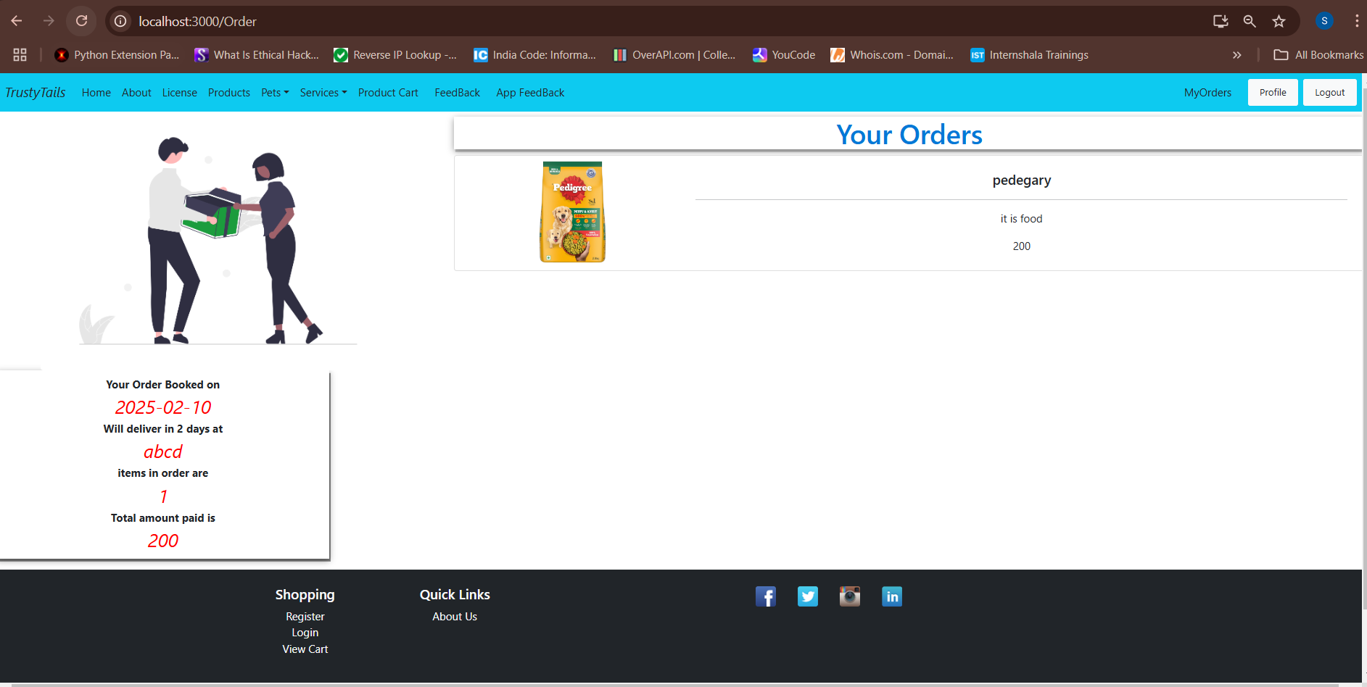

Slide 22
Thank You

